Slide 1
Recitation 0
9/3/21
Greg & Will

Slide 2
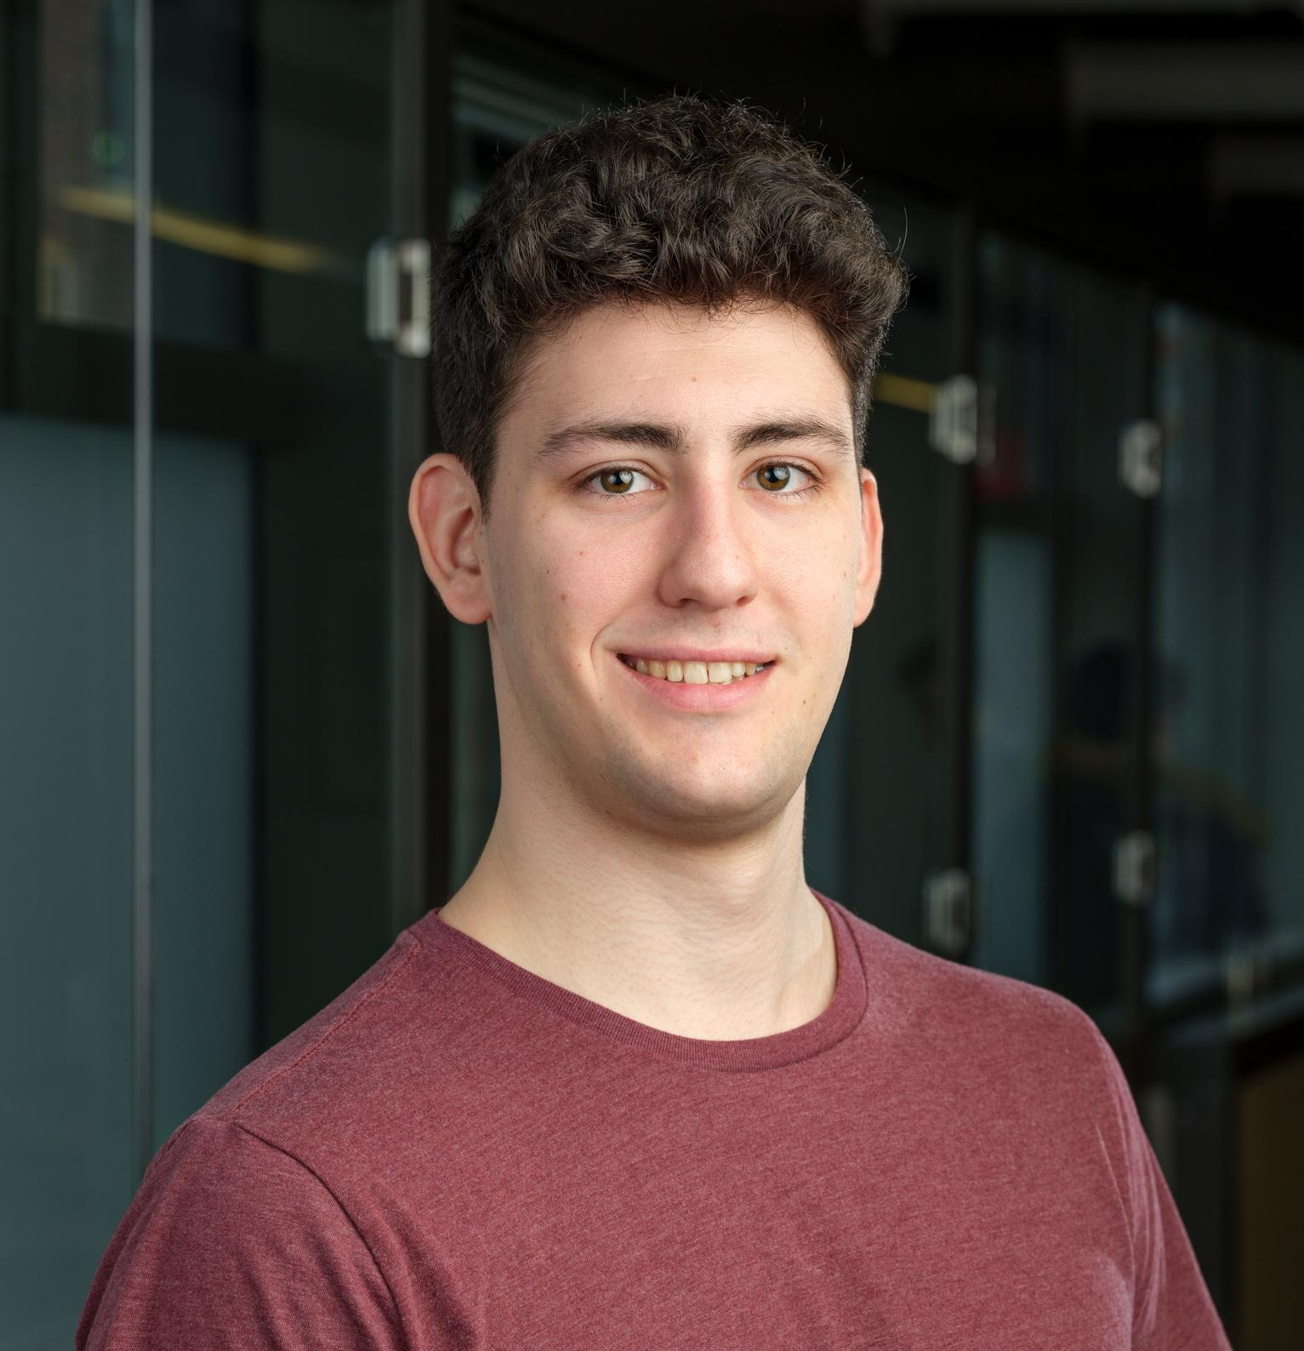
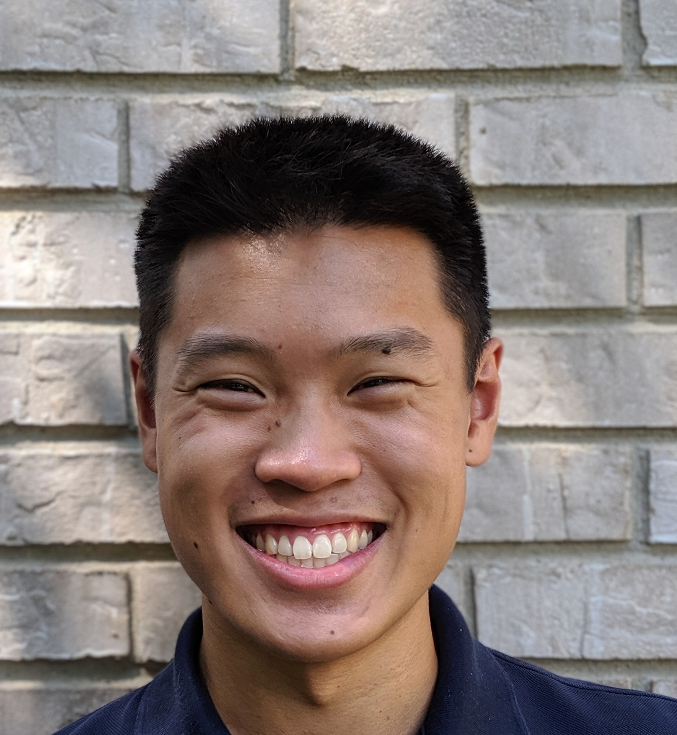
Welcome to MEAM510 Recitation
Greg Campbell
Will Yang

Slide 3
Labwork
Most of the work for this class with be hands-on
TA’s will help, but so should classmates!
Use Piazza.
Don’t be afraid to ask for help.

Slide 4
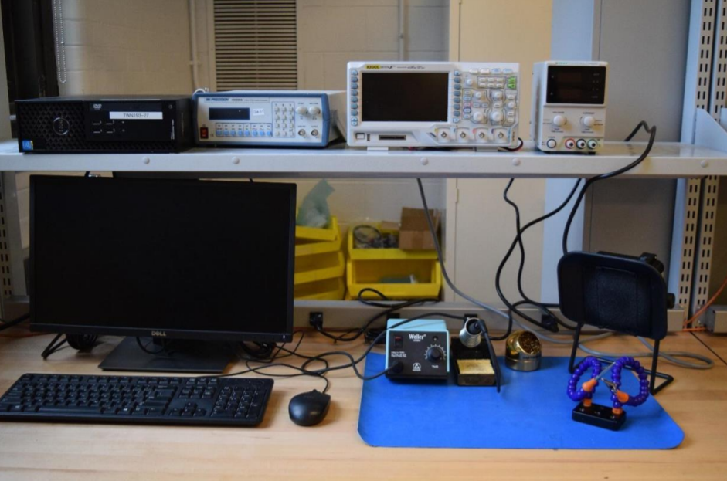
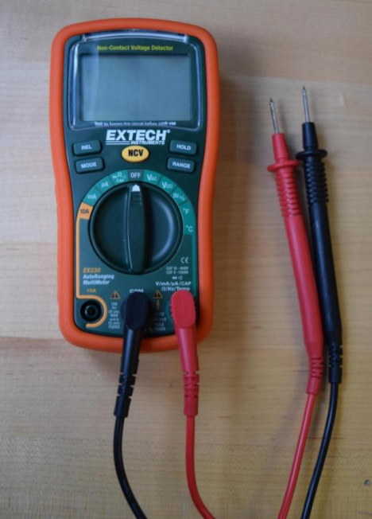
Lab 0 - Equipment

Slide 5
Lab 0 - Equipment
Function generator
Oscilloscope
Power Supply
Computer
Digital Multimeter
Fan
Solder Iron
3rd Hand

Slide 6
Difficulties
Datasheet for Digital MultiMeter (DMM)
Don’t put your DMM in the power outlets… Why not?
Pay attention to the settings
O-scopes can be tricky
Double check the probes
Make sure it’s grounded
Don’t forget to hit ‘start’
‘Auto’ is your friend

Slide 7
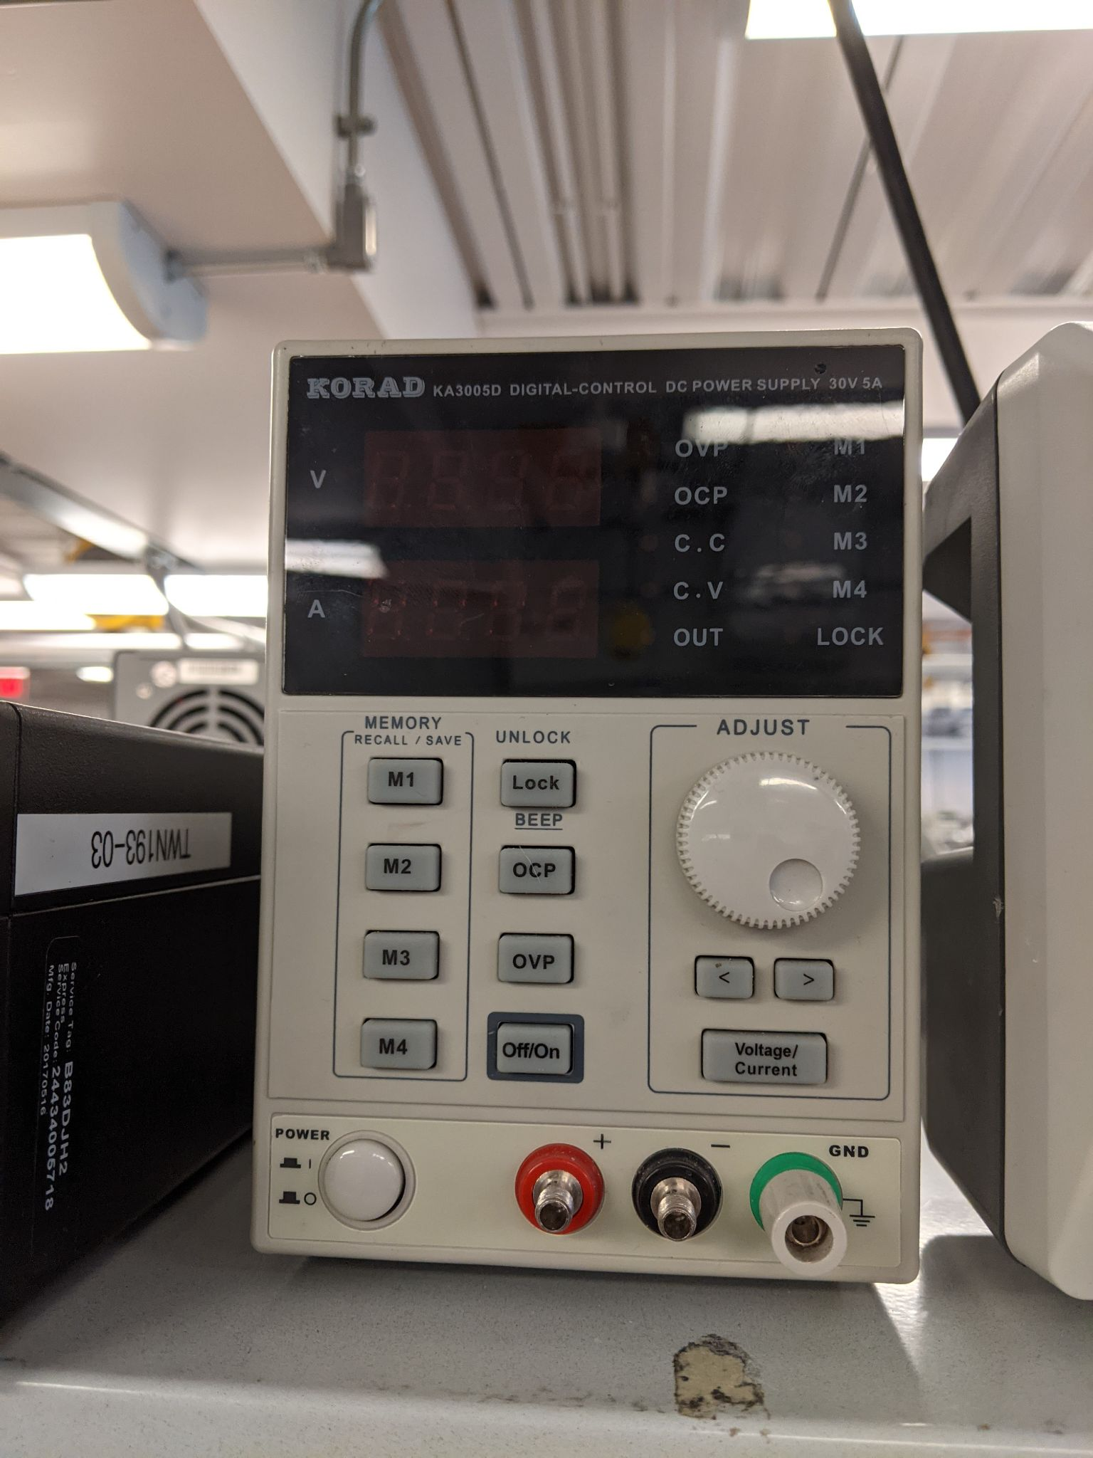
Power Supply (Voltage Generator)
Constant Voltage or Constant Current?
How do you change voltage?
How do you limit current?

Slide 8
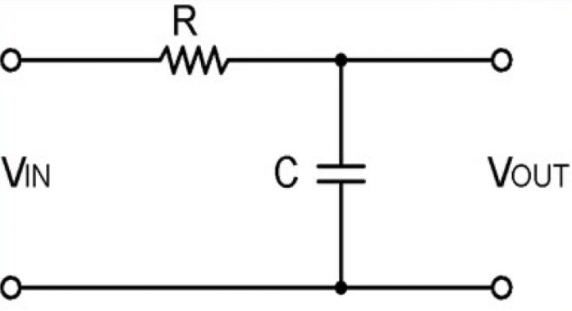
Digital multimeters - common pitfall
Notes:
Voltage or current?
Where would we put it for current? DON’T FORGET TO CHANGE LEAD.

Slide 9
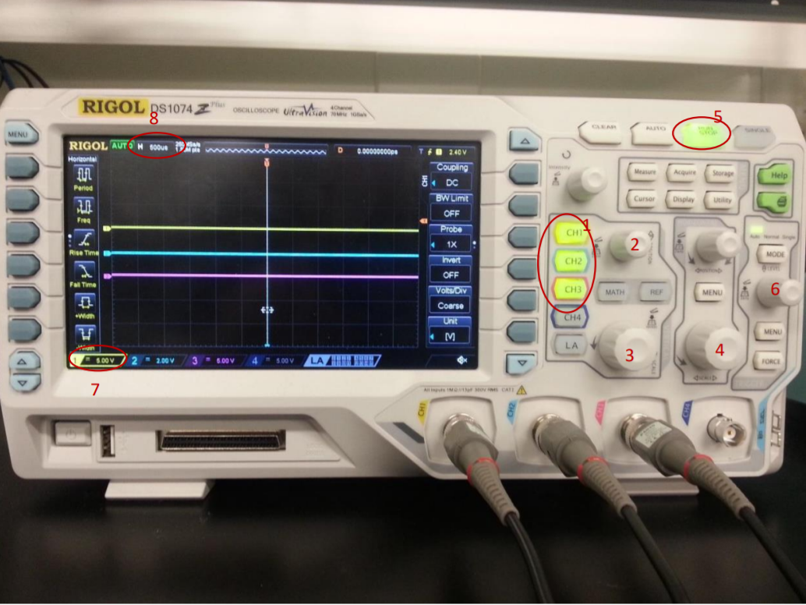
Oscilloscope
Take your time going through the steps in the lab.
Don’t be afraid to use the auto feature, but know how the others work
Verify that O-Scope is working (including probes) BEFORE hooking it up to your project
Function generator is great for this.

Slide 10
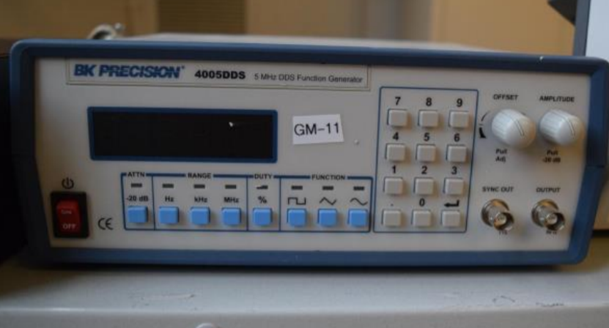
General Terminology
Frequency
Hz, 1/Period
Period
s, 1/Frequency
Duty Cycle
%, ON time
Waveform
Sine wave
Square wave
Triangular wave

Slide 11
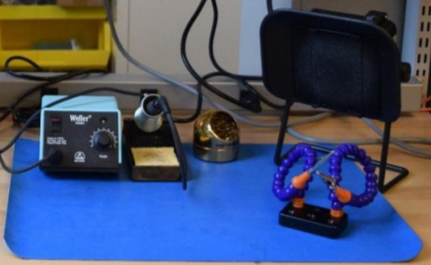
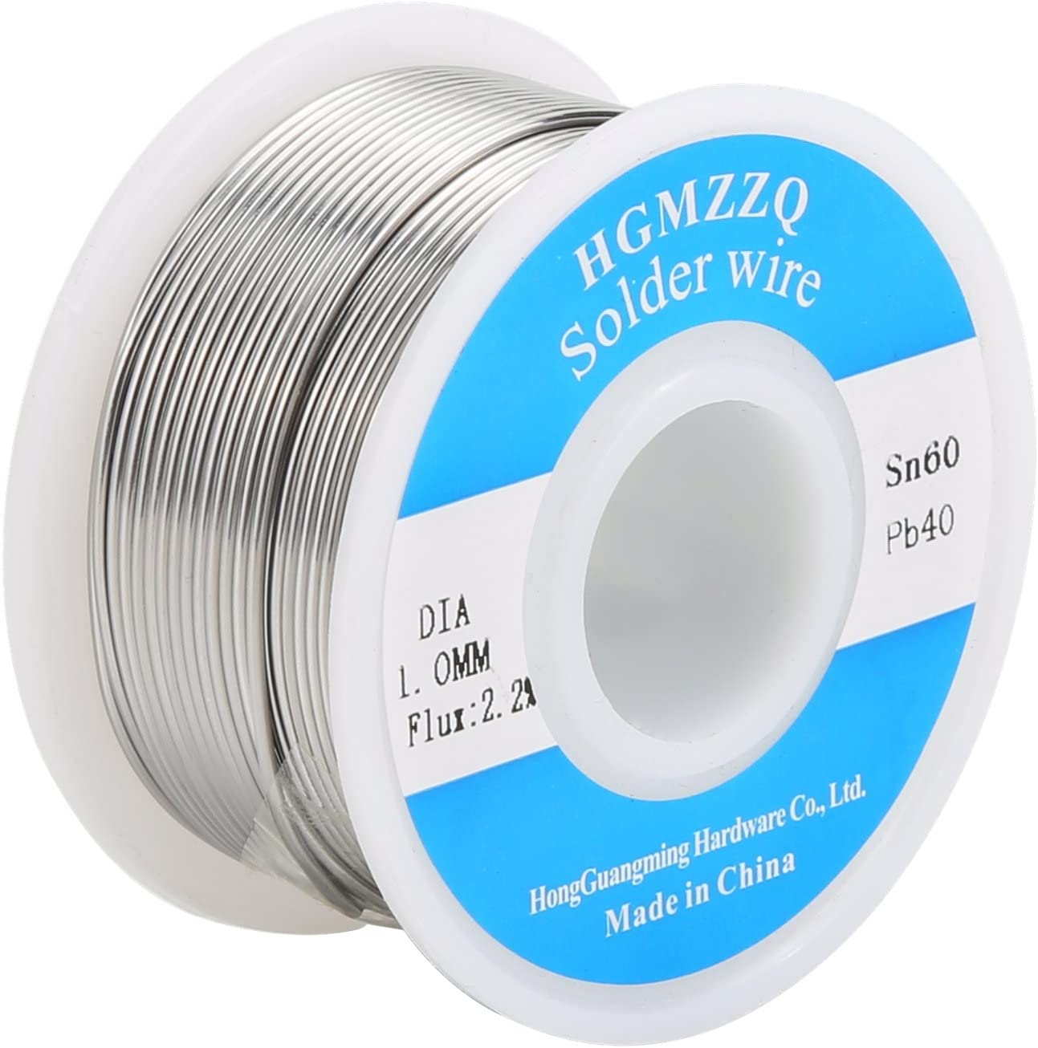
For later… Soldering
Cleaning iron tip
Don’t just poke, drag.
3rd Hand
Use it.
Fan
Use it.

